Slide 1

Making an early bird
Early bird
4조 201835428 김원우 201934624 신재규 201932927 양다인 202037071 정지우

Slide 2
Table of Contents
Introduction of the Team Project
Process of the Project
3. Project Video
Hardware Components
Flow of Software Code
6. Impression

Slide 3
Introduction

Slide 4


Division of Roles
Team leader & Presentation: 201932927 양다인
Hardware: 201835428 김원우
Software & Video Editing: 202037071 정지우
Ppt: 201934624 신재규

Slide 5

Team Name:
Early Bird
Our project purpose is waking up people in the morning.
It reminds us of the famous phrase “Early Bird Catches a worm”.
Team name “Early Bird” originates from it.
”Early bird catches a worm”

Slide 6


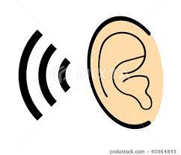
Project Idea:
Making an early bird
Find the Idea in the daily life : Problem of being late or being absent from the class because of oversleeping
Thinking: “How could we not get up late?”
Solution:
1) stimulation of the sense of vision and hearing
2) make people move
Expect these solutions would wake people up definitely.

Slide 7
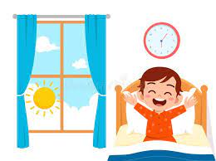

Project Idea:
3 steps of waking people
Stimulation of the sense of vision and hearing
Making people exercise
Waking people up and making them go to school

Slide 8
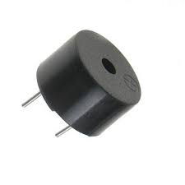


Realization of the ldea with Arduino :
Alarm
Idea + Arduino : Alarm that makes people never keep sleeping
Diverse devices for effective alarm:
Buzzer sound a song “학교 종이 땡땡땡”
→ stimulate the sense of hearing & imply the fact that you have to go to school.
Light comes on in alarm time
→ stimulate the sense of vision

Slide 9
Realization of the ldea with Arduino :
Alarm
Thinking: What if people don’t wake up in this level of stimulation?
Solution: if people don’t wake up within 1 minute, intensify stimulation!
How to intensify stimulation:
The song become faster 1.5 times
The light start to blink

Slide 10



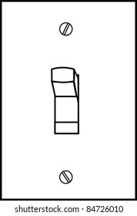
Realization of the ldea with Arduino :
Alarm
Complicated stop process for making people move:
locate one stop button near the bed, locate the other in a distant place.
Press buttons 3 times each in rotation to stop
X 3

Slide 11
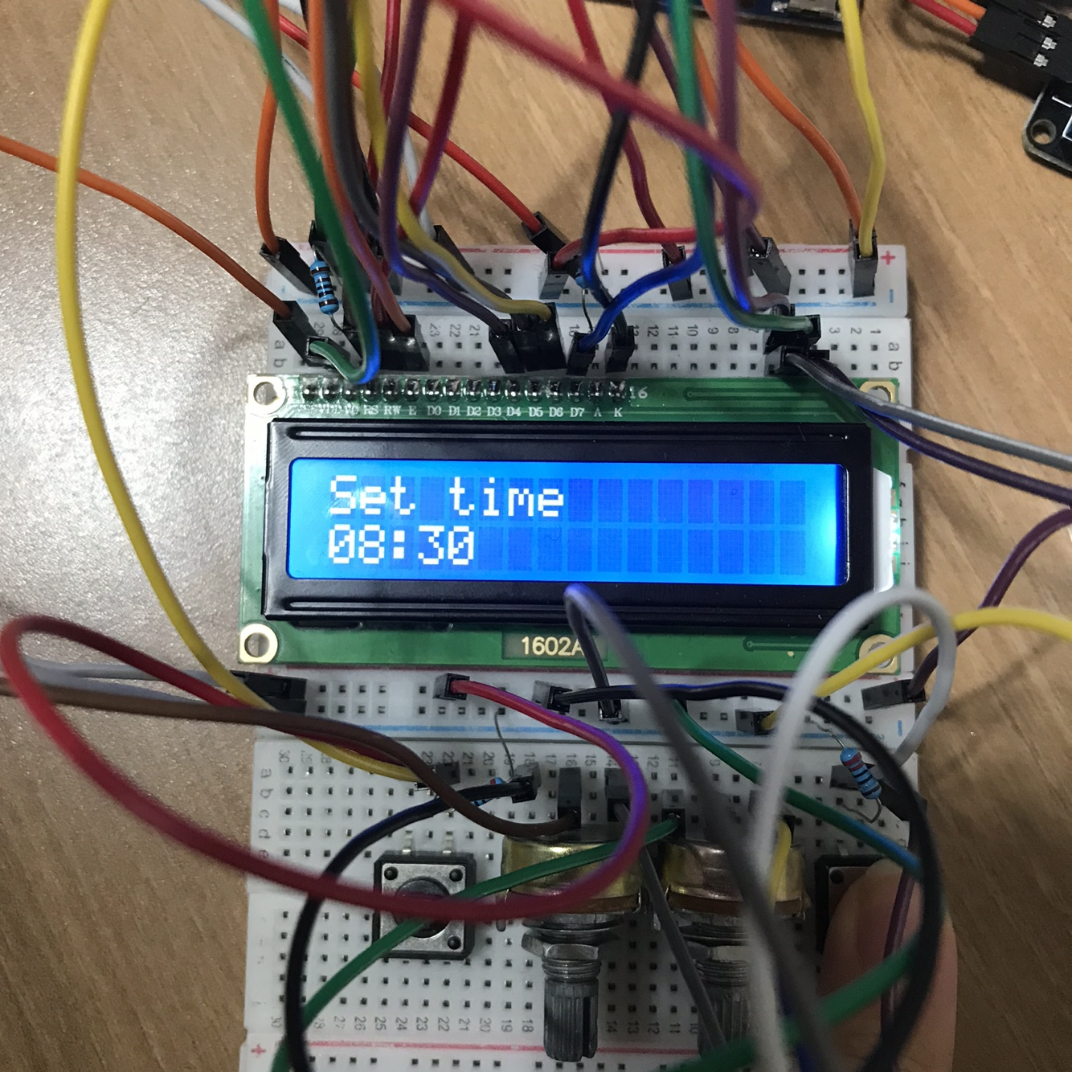
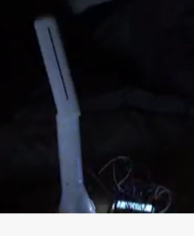
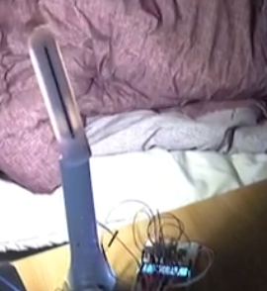
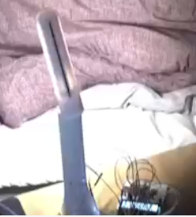
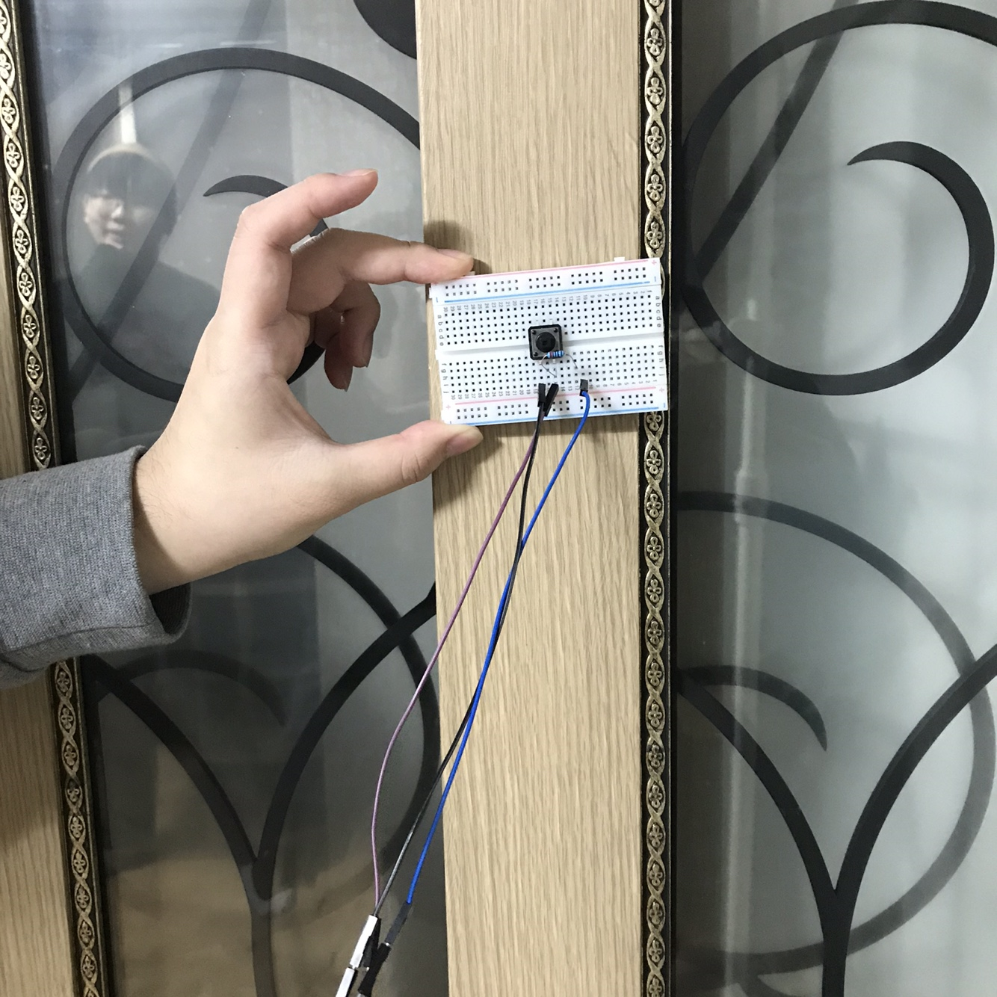
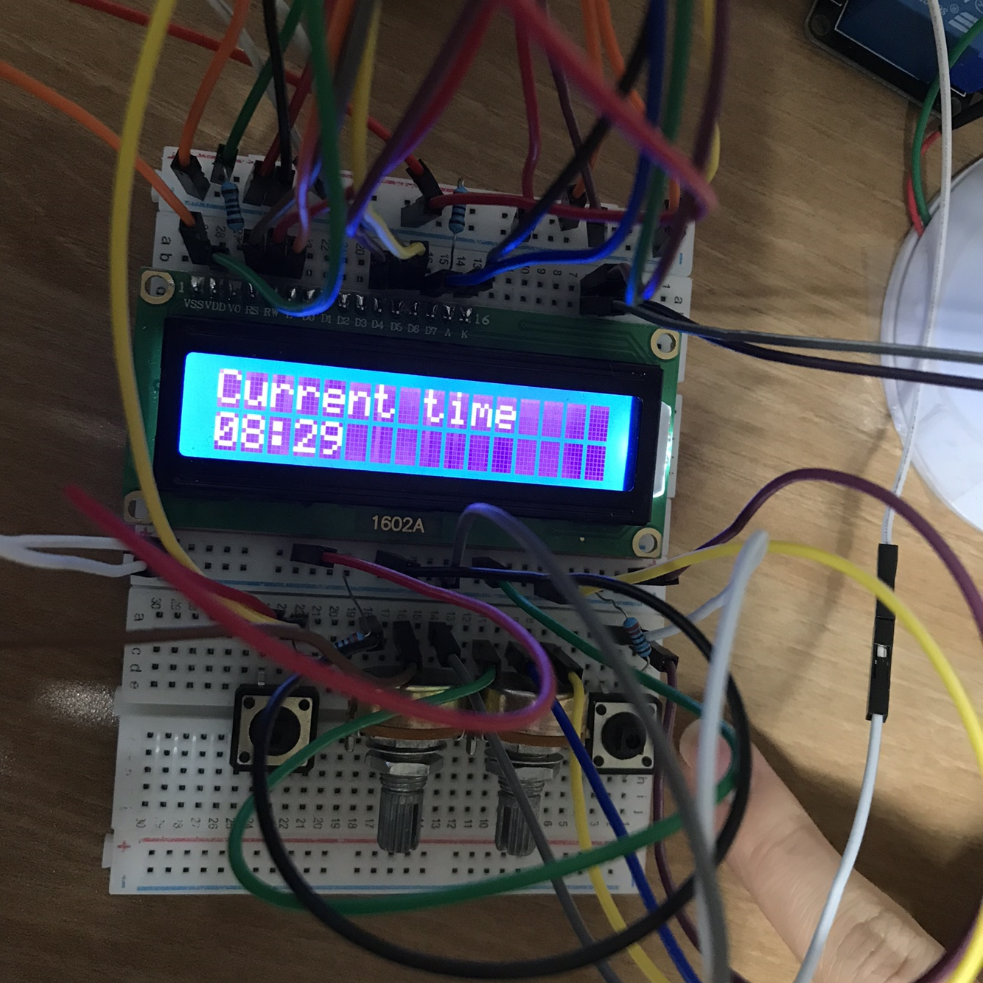
Process
Alarm time
Light comes on & buzzer sound the song
After 1 minute,
The song become faster & light blinks
Set alarm time
Waiting time
Stop button 1
OFF
Stop button 2
Press stop buttons 3 times each in rotation

Slide 12
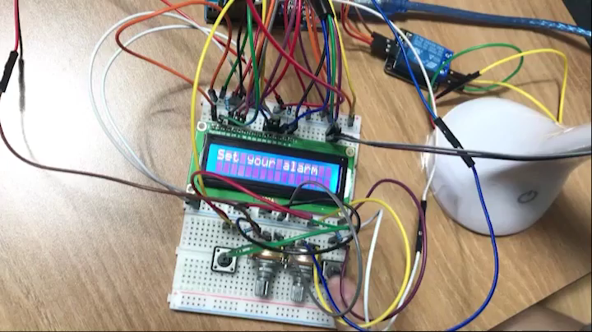
Project video

Slide 13
Hardware Components

Slide 14
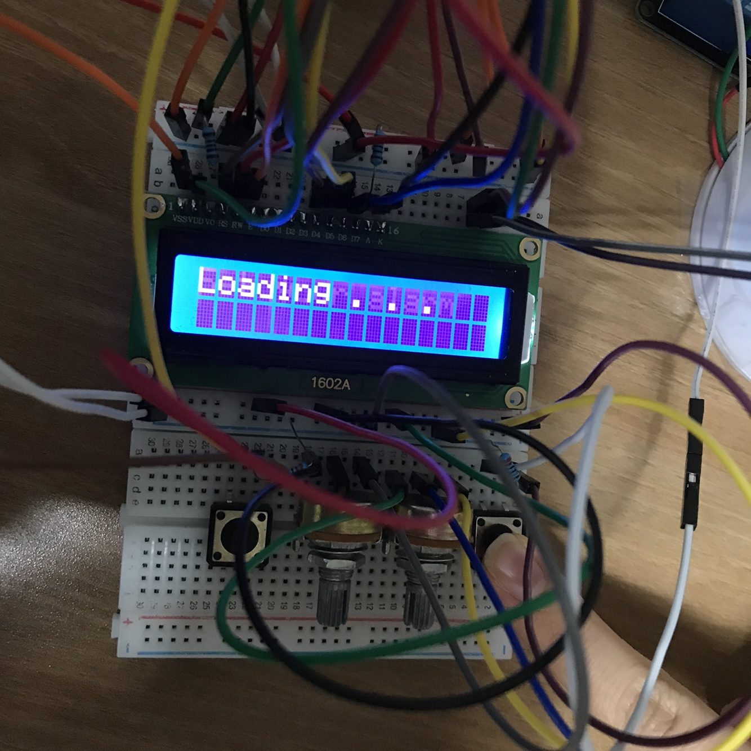
Components:
Set button
Set button is used for:
Setting an alarm
2. Checking an alarm time after setting the alarm

Slide 15
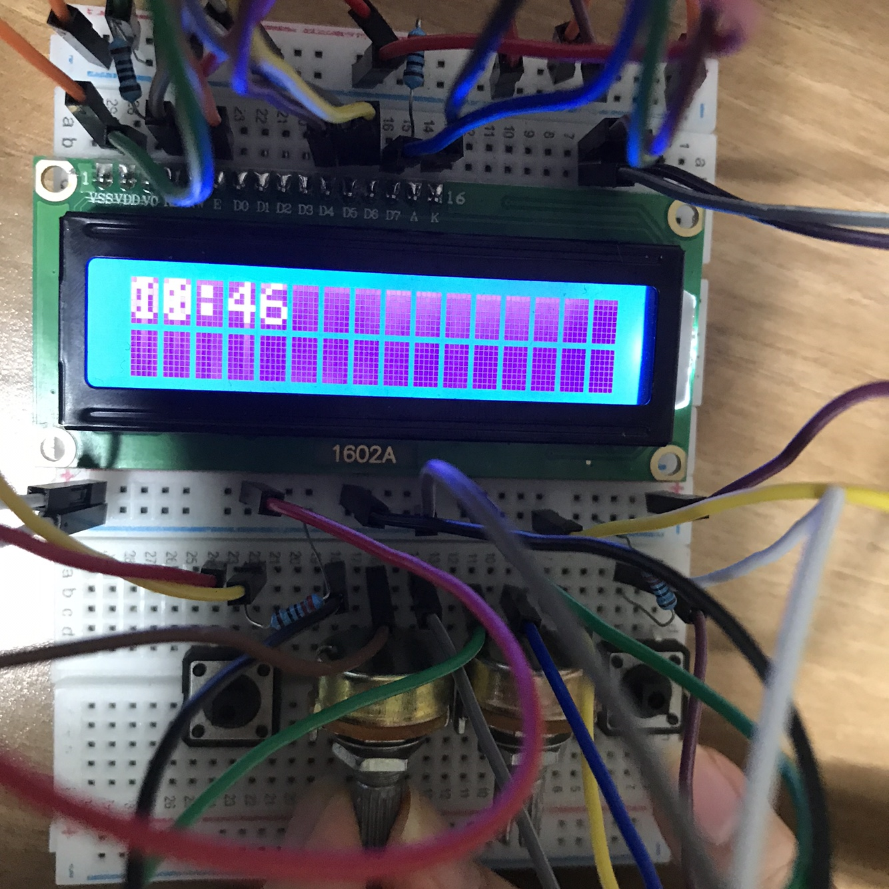
Components:
Potentiometer(resistor) X 2
Resistors are used for:
Setting alarm time
One is for hour, the other is for minute

Slide 16
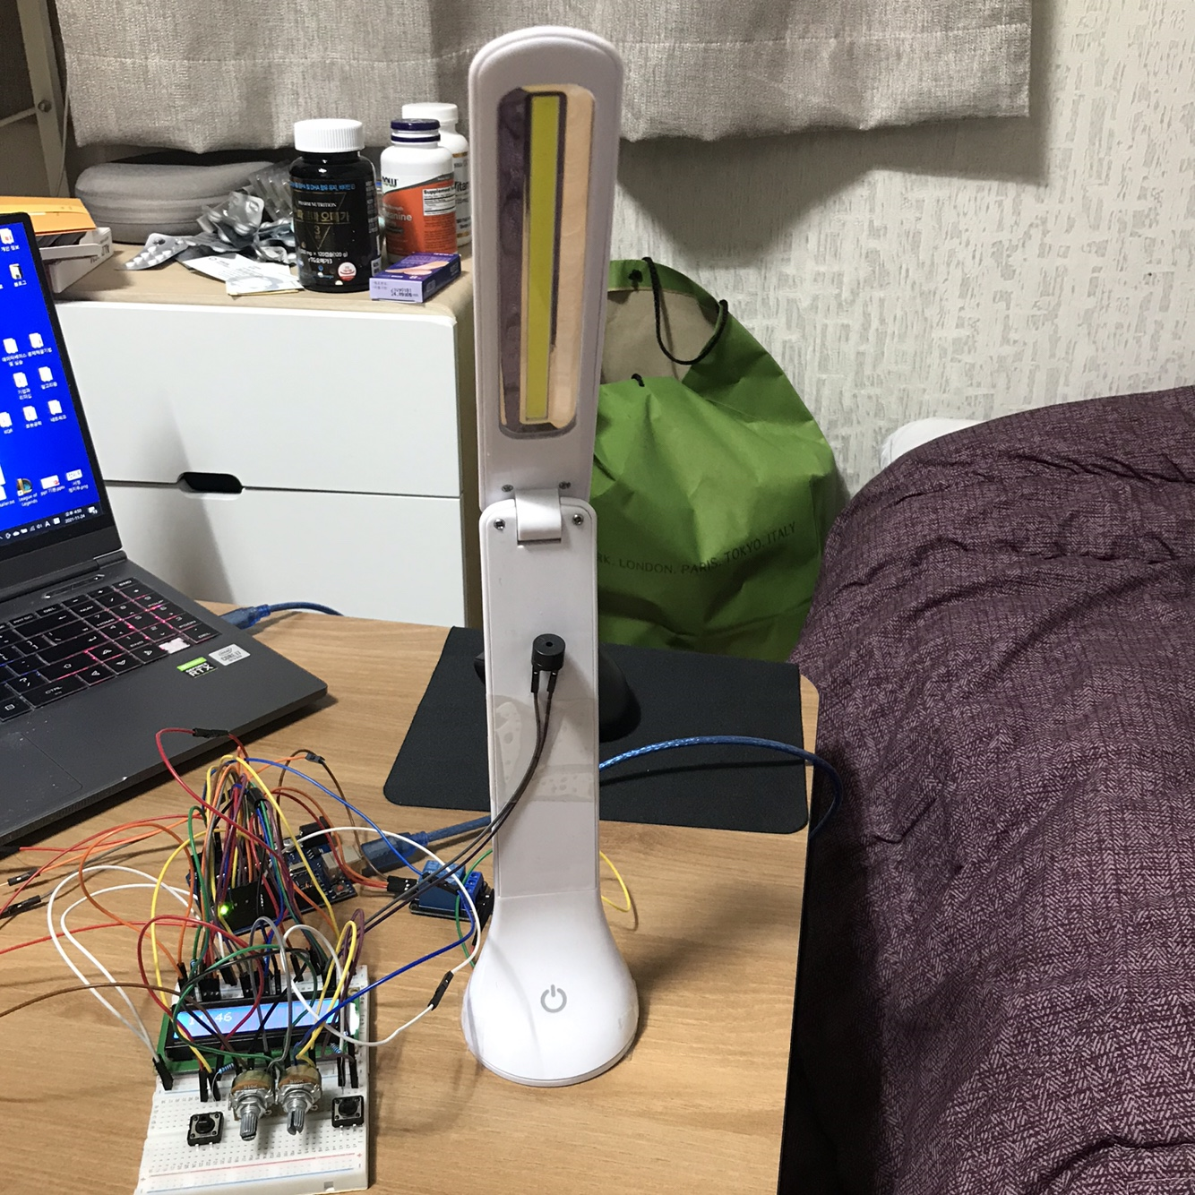
Components:
Light
Light:
Output device
It comes on in alarm time
Stimulates the sense of vision

Slide 17
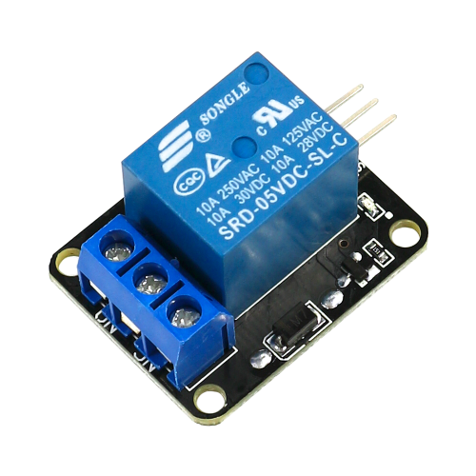
Components:
Relay
Relay:
Connected to the electric wire of the light
Controls electricity of the light

Slide 18
Components:
Buzzer
Buzzer:
Output device
Makes a sound in alarm time
Stimulates the sense of hearing

Slide 19
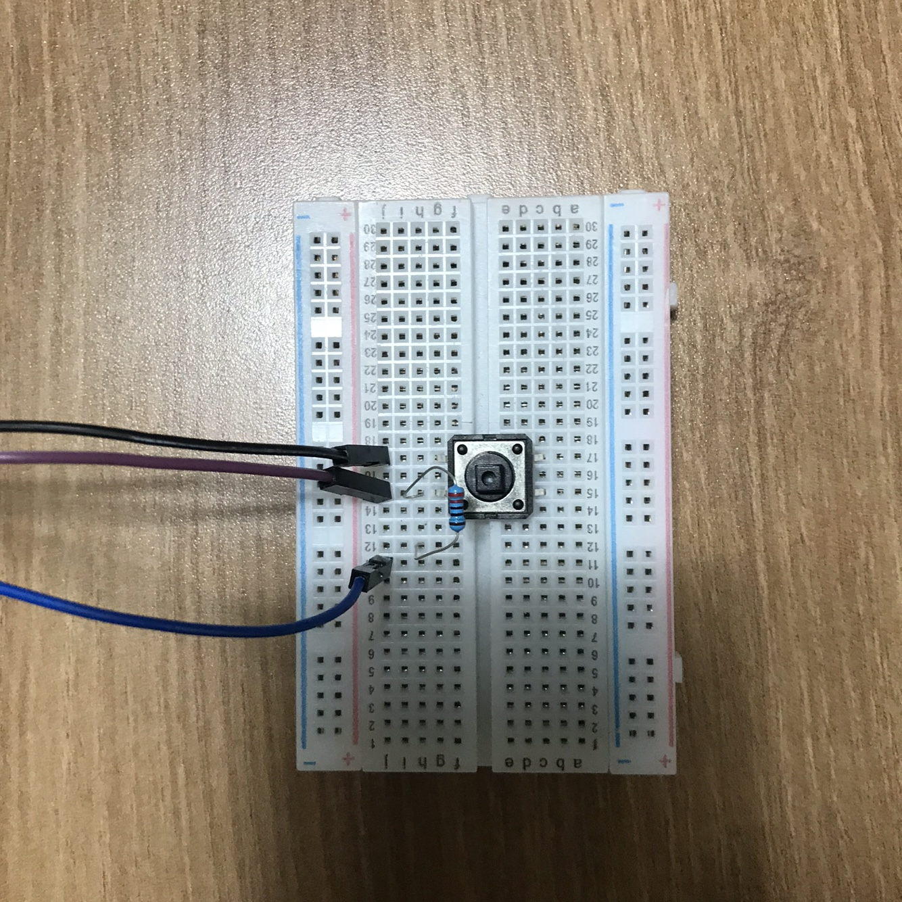
Components:
Stop Button X 2
Stop buttons:
Input devices for stopping
the alarm
If buttons are pressed 3 times
each in rotation, the alarm stops

Slide 20
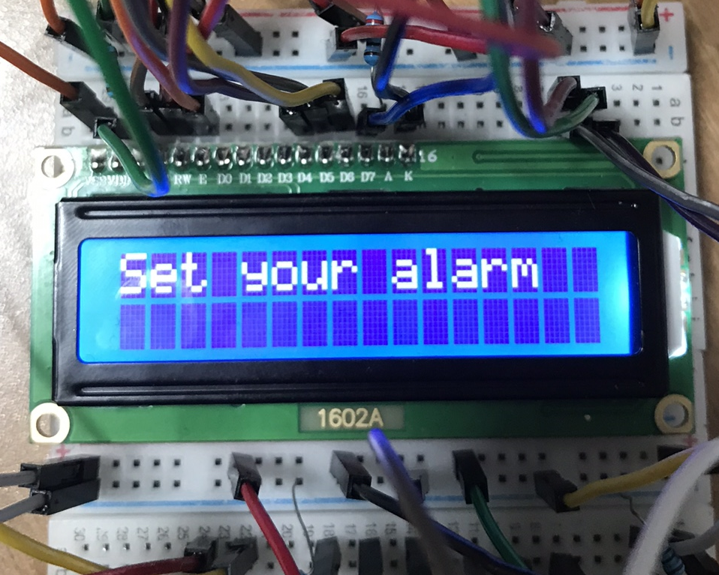
Components:
LCD
Lcd:
Shows current time basically
If you press set button,
lcd shows alarm time 1 second
Shows some important
informations, ”Set alarm”,
“Wake up”, “Loading”, etc.

Slide 21
Software

Slide 22
Code flow
Set up
Set up( ){
set Time( start time );
}
//Set the current time
// Role as a clock

Slide 23
Code flow
Loop
loop ( ) {
set_alarm( ){
}
waiting_alarm( ){
if( ){
}
}
alarm_time( ){
while( ){
}
}
reset( );
}
//call print time function
Print_time(alarm time); //Print alarm time on LCD
//call Print_time function
Print_time( current time); //Print current time on LCD
//when you press set button
//call Print_time function
Print_time( alarm time ); //Print alarm time on LCD
//call Print_time function
Print_time( alarm time ); //Print alarm time on LCD
//call Light_on function
Light_on( ) //light comes on
//call Ringing function
Ringing( ) //buzzer rings the song ‘학교종이 땡땡땡’ + light blinks
//call Counting_stop_buttons function
Counting_stop_buttons( )
//count the number stop buttons are pressed

Slide 24
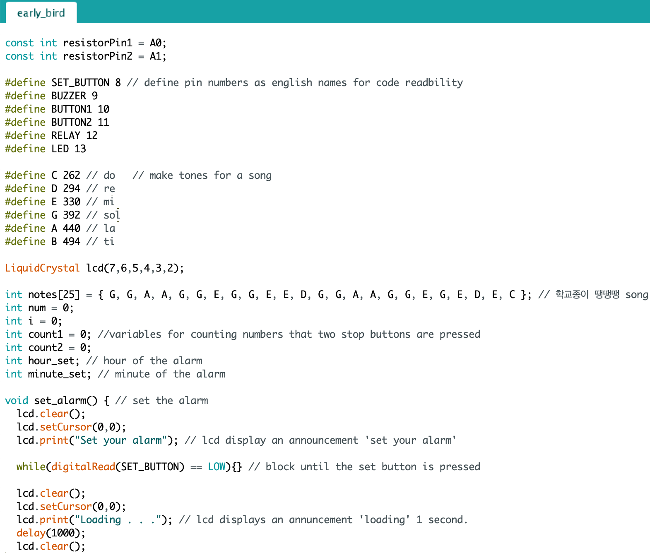
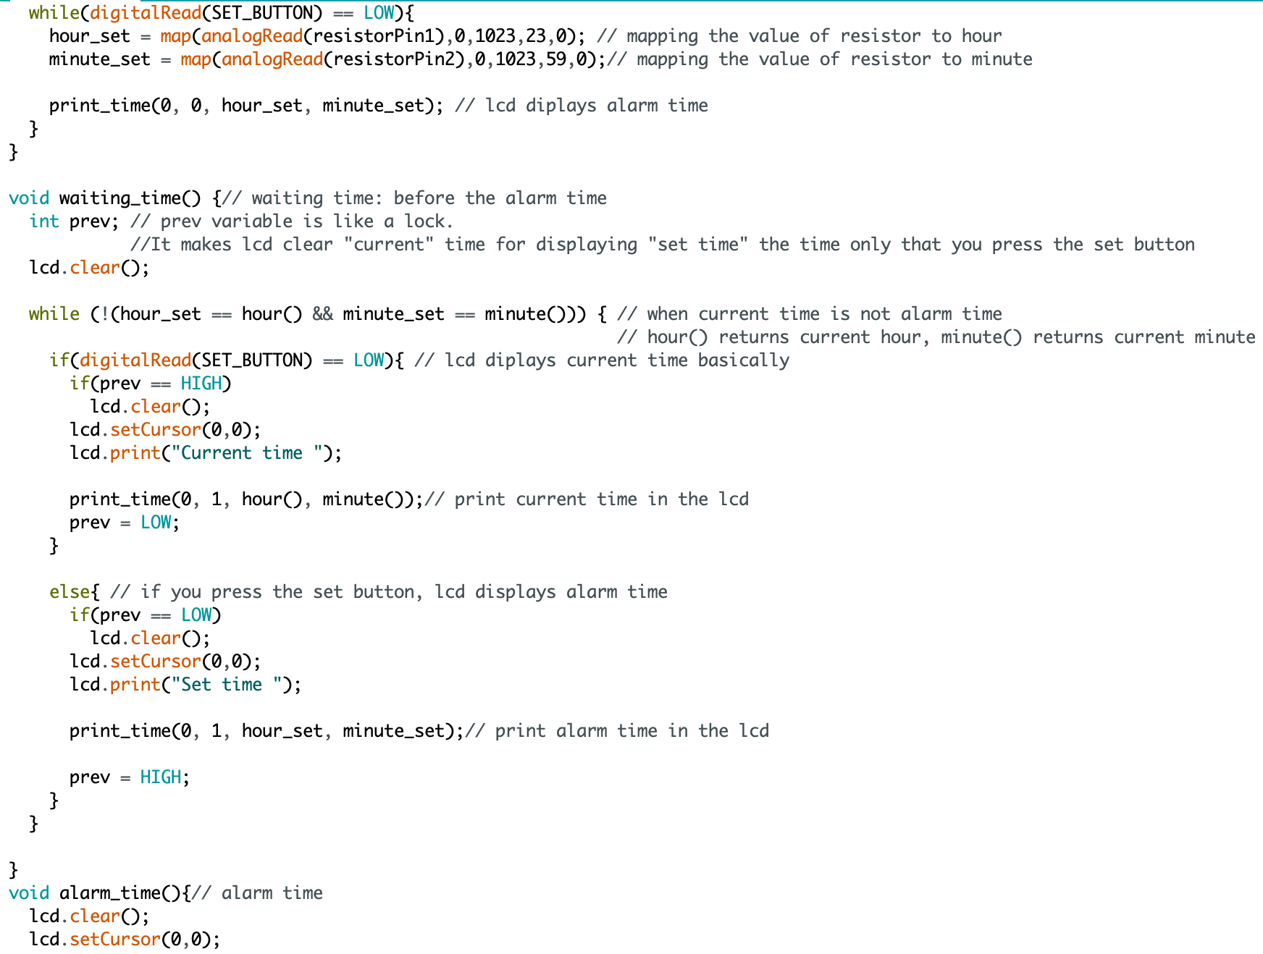
Code

Slide 25
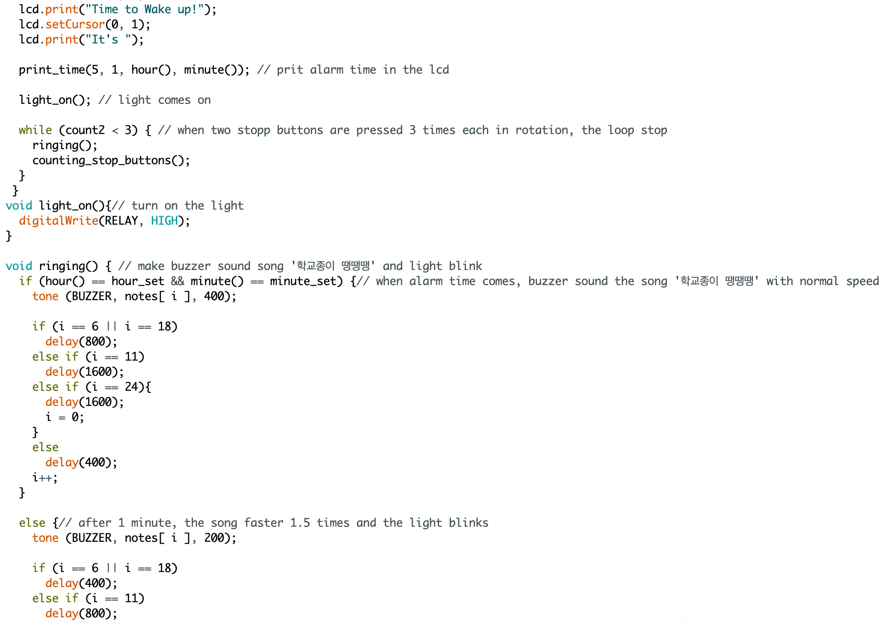
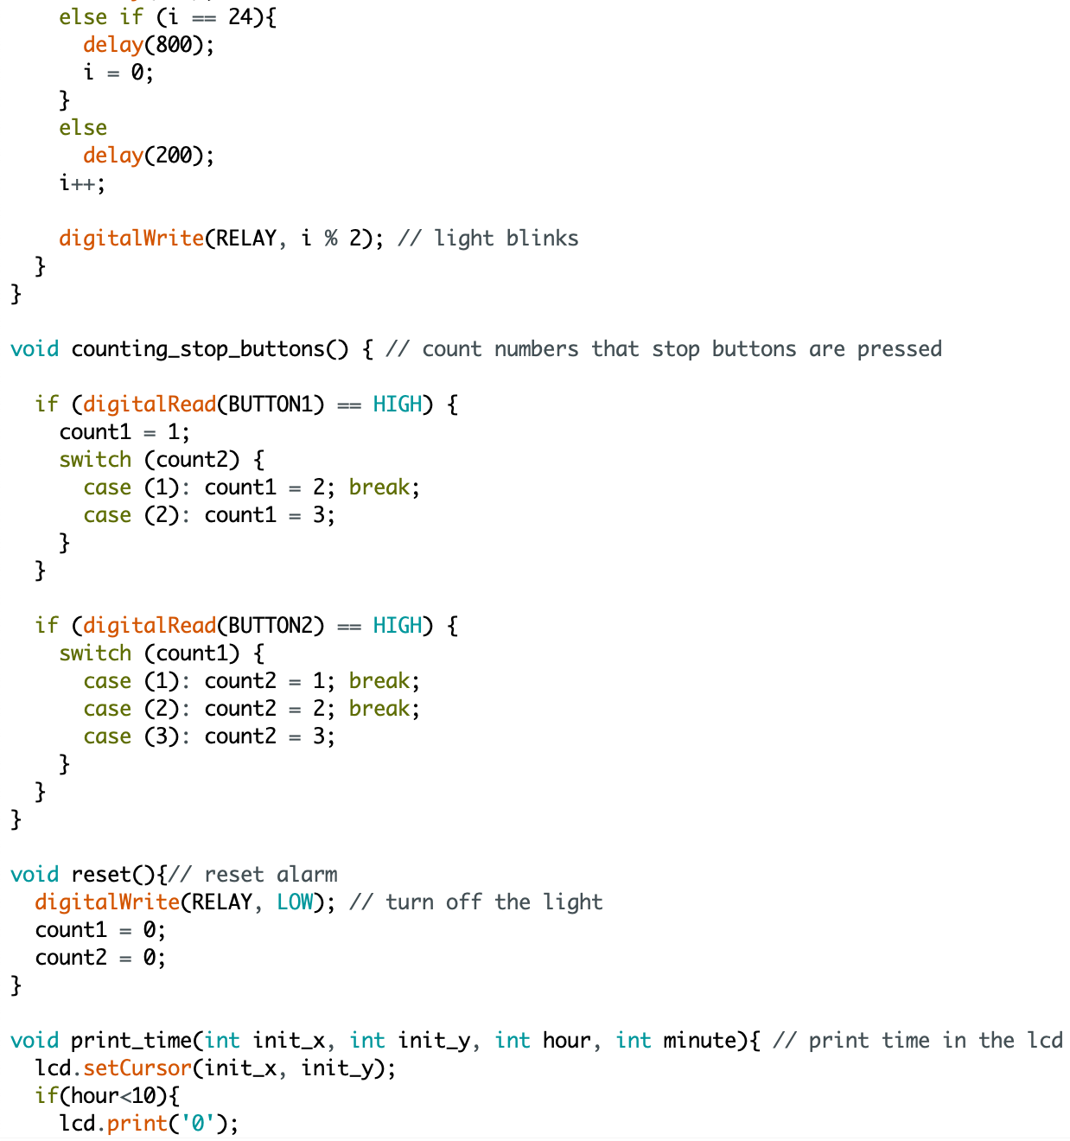
Code

Slide 26
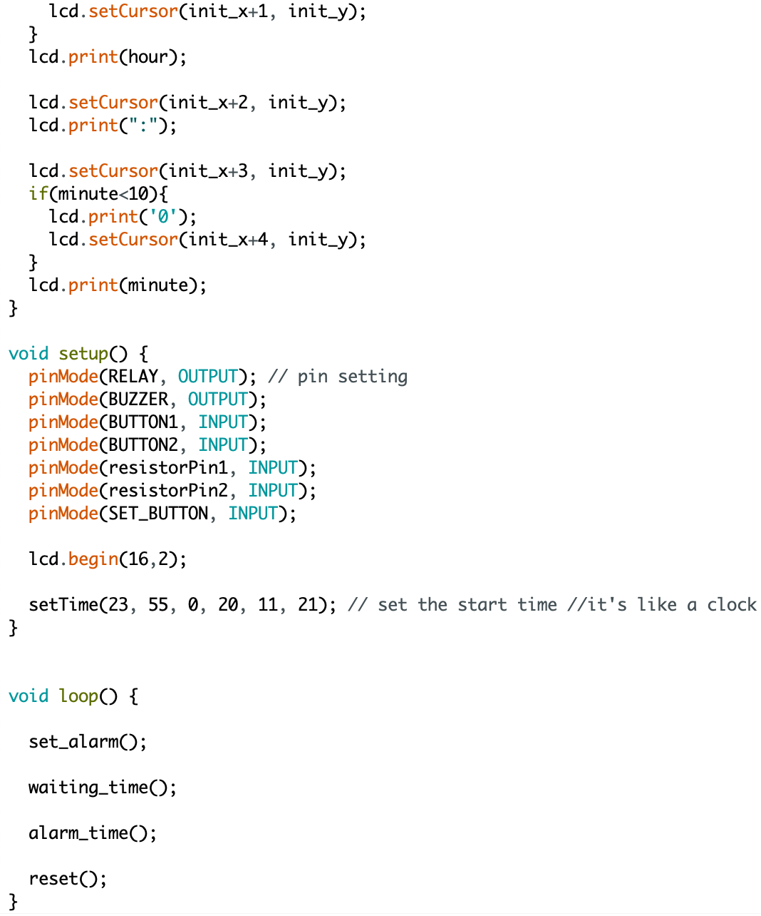
Code

Slide 27
Impression
We felt excited designing the alarm
The project gave us a good opportunity for thinking creatively
We experienced the amazing power of cooperation

Slide 28
Thank you

Slide 29
Resource
https://t3.ftcdn.net/jpg/02/21/32/34/360_F_221323425_olruUrsL9al57ebq7qmMsTuFlnVgaw5F.jpg
https://encrypted-tbn0.gstatic.com/images?q=tbn:ANd9GcTYEnEkUCDOUp2GT9dqVR5eMgM58YaaTm6WqA&usqp=CAU
https://en.pimg.jp/040/064/845/1/40064845.jpg
https://st2.depositphotos.com/3431221/12099/v/950/depositphotos_120997716-stock-illustration-runner-illustration-vector-running-man.jpg
https://static.vecteezy.com/system/resources/previews/000/580/337/non_2x/sound-waves-vector-illustration.jpg
https://www.pcboard.ca/image/cache/catalog/products/buzzers/piezo-buzzer/piezo-buzzer-01-800x800.jpg
https://st2.depositphotos.com/6741230/11163/v/950/depositphotos_111637772-stock-illustration-black-desk-lamp-vector-illustration.jpg
https://www.123rf.com/photo_114894083_stock-vector-creative-team-flat-design-style-colorful-illustration-on-white-background-a-composition-with-busines.html

